Slide 1
Jobathon – Sales Forecasting
Ramya D
September 2021

Slide 2
Contents
Objective
Background
Brief overview of approach
Pre-processing/Feature Engineering
Final Model

Slide 3




Objective
Predict the store sales for each store in the test set for the next two months.
If we can accurately predict the upcoming cash flows, WOMart can more accurately plan the cashflow at the store level.

Slide 4

Background
Effective insights into upcoming cash flows at a store level is crucial to WOMart’s business strategy.
WOMart is a leading nutrition and supplement retail chain that offers a comprehensive range of products for all your
wellness and fitness needs.
WOMart follows a multi-channel distribution strategy with 350+ retail stores spread across 100+ cities and effective insights into upcoming cash flows at a store level is crucial to its business strategy.

Slide 5
Brief overview of approach
Two-layer stacking model based on ML regressors on engineered features
Our modelling approach is to build a regression model rather to estimate the store value whether it is future, current or past with respect to the given data instead of simply building a forecast model at each store level to forecast the future sales data.
The advantage of our approach is that it restricts the complexity and number of models require to model Sales at a store level
Also given the additional information available like discount and holiday etc, this approach helps us to account these effects as well unlike the classic time series/statistical models which needs explicit modeling based on exogenous variables
We have built a two layer stacking model with LR, RF, XGB, GB, BAG regressors in the first level with a Elastic net in second level using engineered features to account seasonality present in the dataset

Slide 6
Pre-processing/EDA/Feature Engineering
Standard data checks on train dataset
Sl.No | Check | Presence in Data | Approach
1 | Incorrect rows | None
2 | Summary rows | None
3 | Dulicate/Extra/Unnecessary rows | None
4 | Missing Column Names | #Orders not present in Test | Excluded from modelling
5 | Inconsistent column names | None
6 | Unnecessary columns | Row ID | Excluded from modelling
7 | Columns containing Multiple data values | The data is a collection of time series data of 365 stores
8 | No Unique Identifier | None
9 | Misaligned columns | None
10 | Disguised Missing values | None
11 | Significant number of Missing values in a row/column | None
12 | Non-standard units | No mention of currency | Ignored
13 | Abnormally high and low values | None
14 | Non standards in text variables | None
15 | Incorrect data types | Store id is given as an integer | Treated it as a categorical variable and relevant encoding performed
16 | Correct values beyond range | Sales and orders are non-negative
17 | Validate internal rules | Sales is zero when orders is zero and vice versa/ Each store has exactly 517 observation of time series

Slide 7
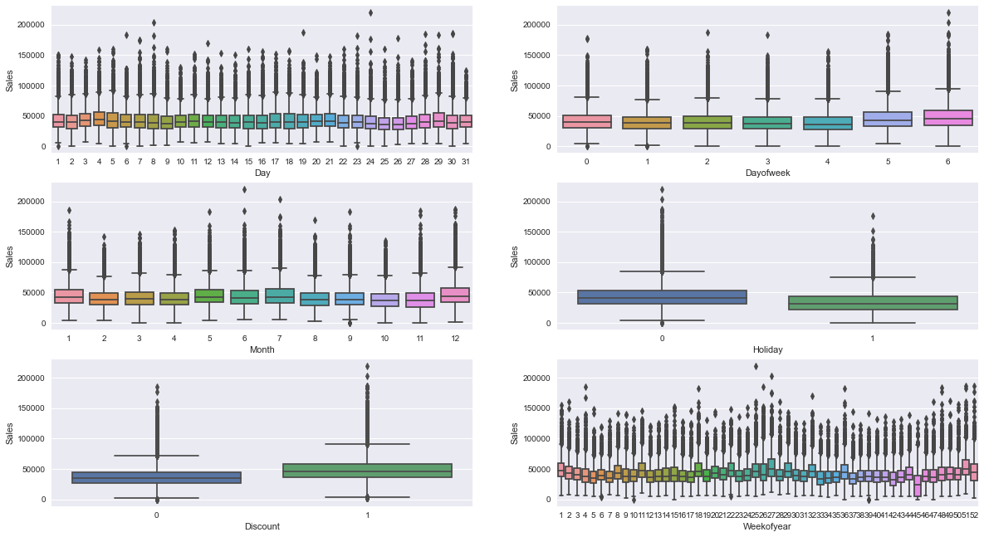
Pre-processing/EDA/Feature Engineering (contd)
Sales is a highly seasonable variable – Discount and Holiday has a great effect on it

Slide 8
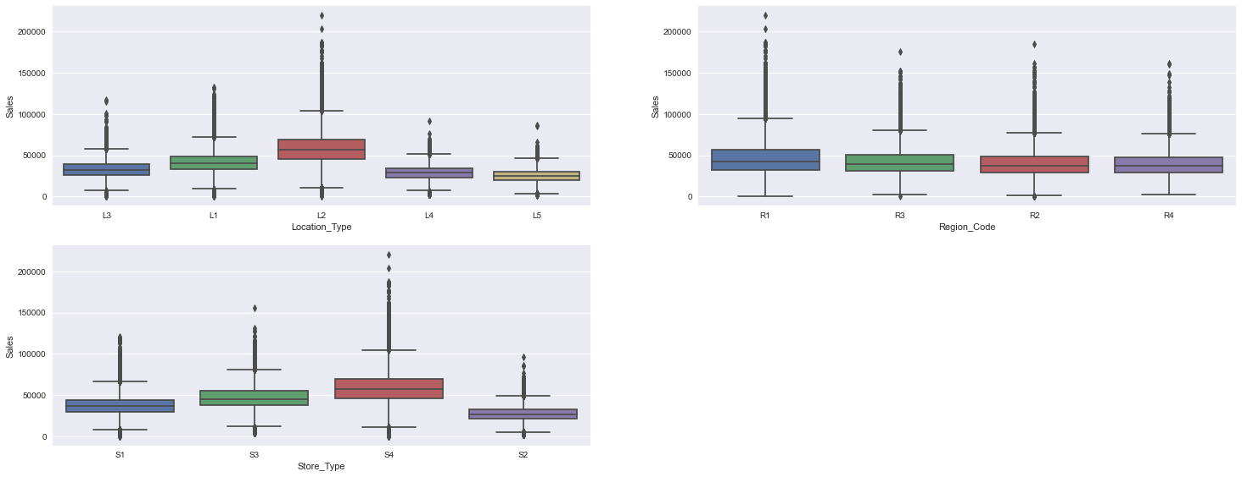
Pre-processing/EDA/Feature Engineering (contd)
L2 location and S3 store type generate higher sales on an average

Slide 9
Pre-processing/EDA/Feature Engineering (contd)
Engineering various features from the Date column
Extracted following variables from Date column
Month
Day
Day of year
Week of year
Day of week
Is month start/end, Is quarter start/end
Transformed seasonable variables Month and Day with sine and cosine transformations to have a period of 12 and 7 respectively.
Target encoding for store_id variable based on median of sales.
Transformed Sales column based on Yeo-Johnson transformer to convert into a variable that follow normal distribution

Slide 10
Final Model
Engineering various features from the Date column
Split the dataset into Train (data till 31 December 2018) and Validation (remaining portion starting from 1st January 2019
Train
Validation
Unseen
Jan 1, 2018
Jan 1, 2019
July 1, 2019
Sep 1, 2019
Built the below models on Train dataset with transformed Sales as target. All the Hyperparameters are tuned using a 10 - fold Grid search CV
Linear Regression, Random forest Regressor, Gradient boost Regressor, XGB Regressor, Elastic net is used as Meta model in level 2

Slide 11
Final Model
Engineering various features from the Date column
Sl.No | Model | R2 score | RMSE
1 | Linear Regressor | 58.58 | 12529
2 | Random forest Regressor | 57.18 | 12739
3 | XGB Regressor | 63.33 | 11788
4 | Gradient Boosting Regressor | 64.04 | 11673

